Slide 1
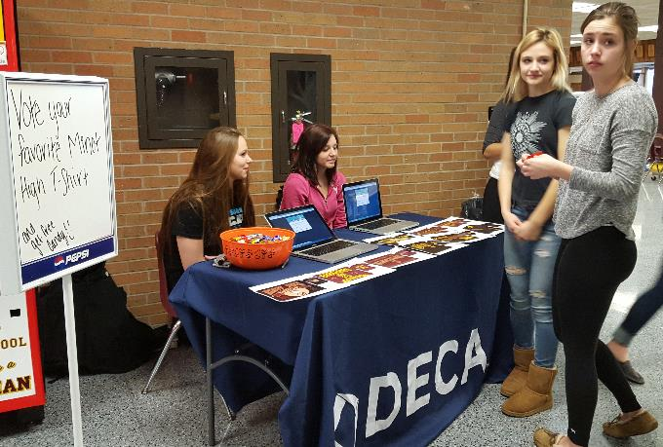
MHS DECA Chapter Activities

Slide 2
Professional Points
Earn “Professional Points” for your involvement in club activities
Earning points is like fundraising
The more points earned, the more paid by MHS DECA to attend conferences (max to ½ total cost paid based on your involvement)
Also, the ONLY way to earn a bonus point for class
All Events are posted on the DECA Calendar, DECA Bulletin Board, and announced in Class

Slide 3
“Earn Your Way”
The more you participate, the more “points” you earn. Points earned pay up to ½ of student costs to attend conferences.
Conference | Cost Based on Points Earned
Fall Leadership Conference | Students Pay from $25.00 to $75.00
Central Region Leadership Conference | Students Pay from $600 to $1200
State Conference | Students Pay $60 to $120
ICDC - National Conference | Students Pay $700 to $1400

Slide 4
Earn through Club Activities
Attending DECA Meetings – officers & class reps
Attending DECA Socials (all students – 1 per semester)
Chapter Projects – 1 pt per hour worked
Chapter Promotion Projects
Fundraising Projects
Community Service Projects
Participating in DECA Dress Days
DECA T-Shirt Days +1 pt
DECA Professional Dress Day 1pt

Slide 5
Monthly Meetings
Set by officers and posted on the DECA board
Required to attend Class reps and officers – earn 1 pt.
Can only miss two meetings to get a DECA Stole
Members optional – earn 1 pt.

Slide 6
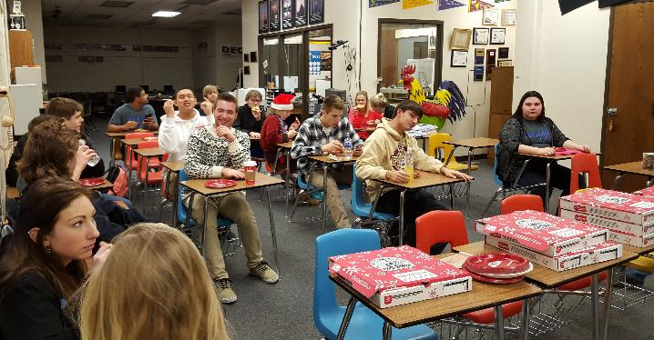
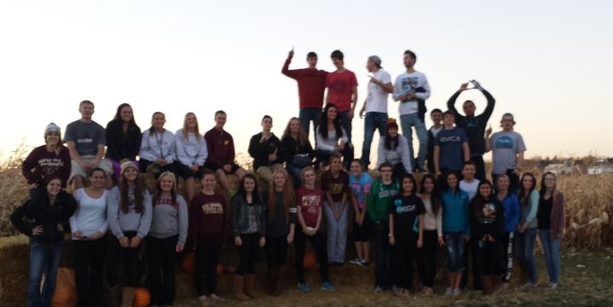
Socials
Once Per Semester:
Required of Class reps and officers – earn 1 pt.
Members optional – earn 1 pt.
Time, location, event, and date chosen and organized by those that attend meetings

Slide 7
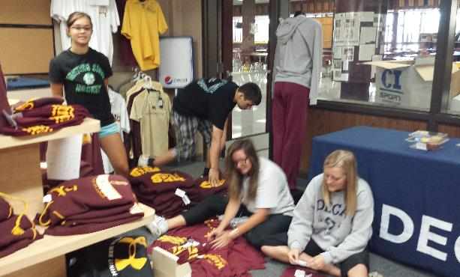
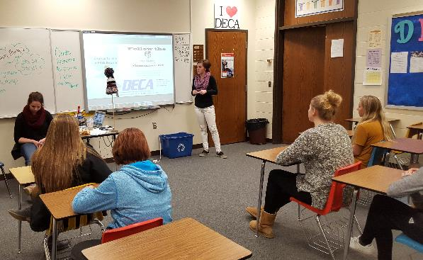
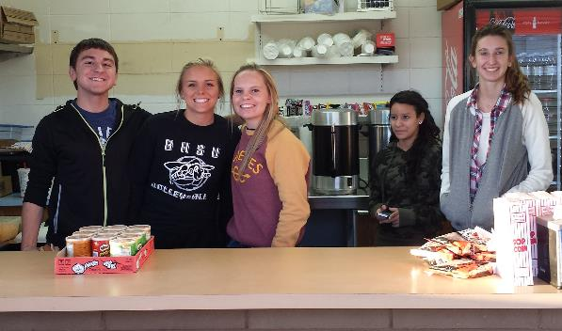
Participate in Chapter Projects
Classroom Required Assignments
Football Concessions – 1st Semester (50pts)
50/50 Sales – 2nd Semester (50pts)
Chapter Promotion Month – November
Create ways to Promote DECA at School
DECA Class Photo
Create a Float for Homecoming parade
Community Service Projects
Organize a Food Drive
Applebee's Pancake Breakfast – sell tickets
MSU Trick or Treat event
Prom Dress Drive

Slide 8
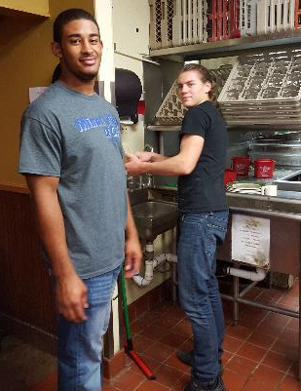
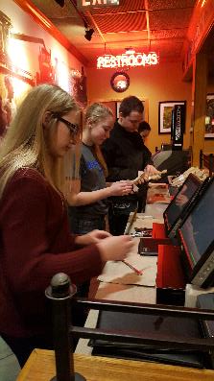
Community Service
Football Games
Everyone works a 2.5 hour shift
50 point assignment
Other Service Events
1 Profession point per hour worked
Events posted on the DECA board

Slide 9
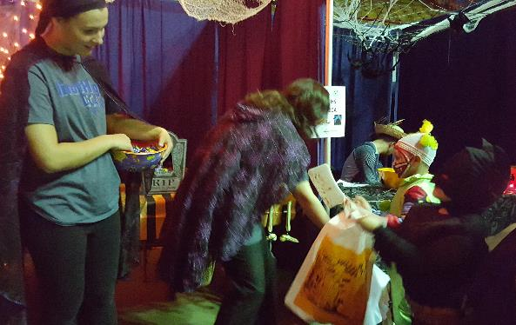
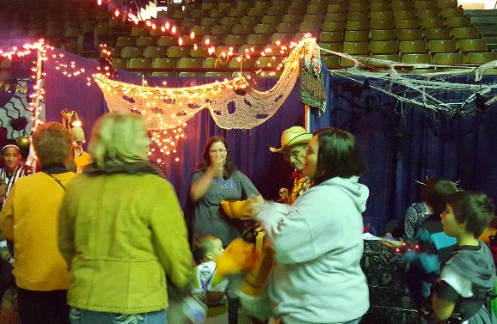
MSU Trick or Treat
Earn 1 professional point per hour worked
Distribute Candy to the community
Setup, Decorate, and dismantle Booth
Time – 3:00 – 8:00 p.m.
Date: Oct 31

Slide 10
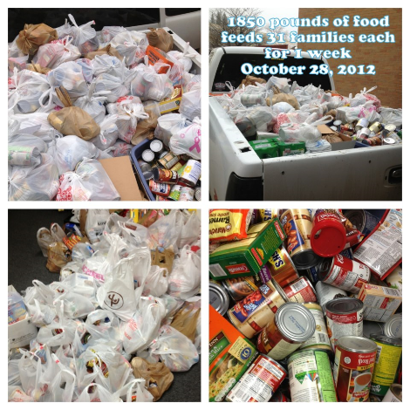
Food Drive
Collect Canned Goods in class
1 point per perishable food item donated
Maximum of 5 points (date announced in class)
Collect Canned goods in store
15% off all 1 apparel item during Parent teacher conferences for every 3 perishable items collected.
Given to Local Food Shelters

Slide 11
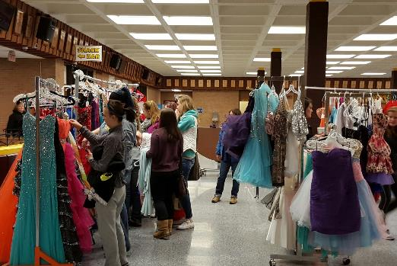
Pretty for Pink
1 professional point per hour worked January, 2020
DECA Sells used prom dresses on consignment
We charge $10 fee per dress
Money collected is Donated to the Pretty for Pink Cancer Campaign

Slide 12
DECA T-SHIRT DAY
Earn 1 Point when you wear your DECA T-shirt
Up to 8 points available

Slide 13
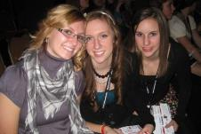
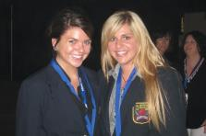
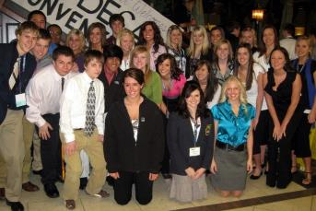
Professional DRESS DAYS
Earn 1 Professional Point
Dress for Success
Dress like you are going to an interview
1 Wednesday per month - Up to 8 points available

Slide 14
Professional DRESS DAYS
Men:
Business suit
Slacks with a collared shirt & tie
Black socks with dark pants
No sports shoes
Women
Business suit or dress
Slacks or skirt with coordinated blouse or sweater
Shirts must have sleeves and no bare mid drift.
Skirts must be at least a finger tip length from top of knee
Not allowed: Denim, athletic shoes, sweat and T-shirts, shorts, hat or yoga pants.

Slide 15
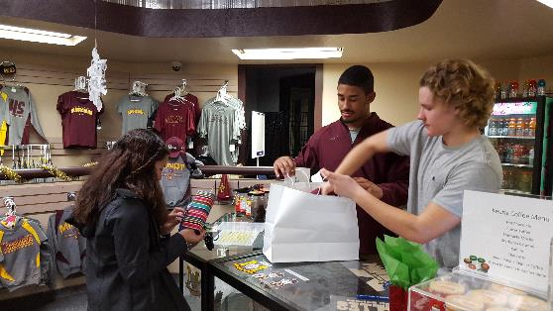
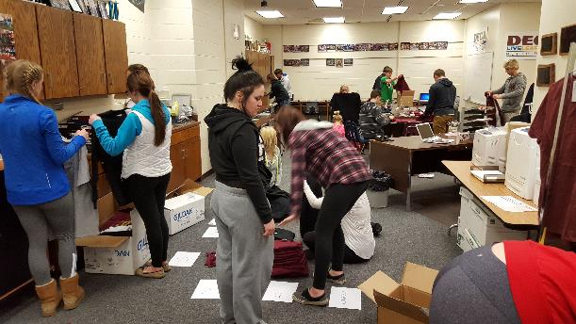
Other Events
Other Events will arise and be posted throughout the year!
Don’t wait too long, most occur the first semester

Slide 16
